Slide 1
Visual Recursion
By: Jonathan Sullivan

Slide 2
General Overview
Description:
Create a visual maze that shows how programs travel through it
General Requirements:
Design a “maze creator” module with the ability to open and save different mazes
Design an API for the maze so that any program has the ability to communicate its location within the maze.
Make the maze visually show current and visited locations along with its state (blocked/unblocked).
Develop a maze UI that has controls: animate, speed, step, undo, redo, reset, etc.
Construct several programs to run on the maze, including instruction type programs that demonstrate depth first and breadth first recursive algorithms
Consider developing a game that uses the maze or an enhanced version of the maze.

Slide 3
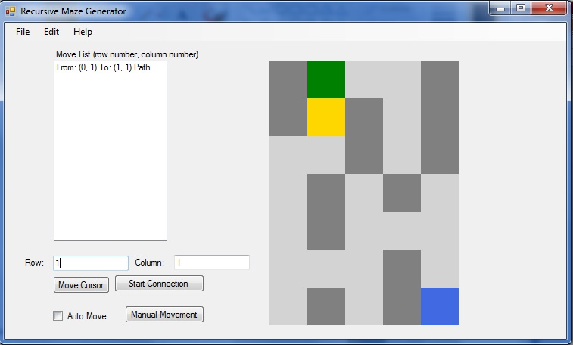
The Pieces
The Visual
Maze
The API
Library of Functions
Notes:
I ended up splitting the project into two pieces, the visual and then the API connection.
The visual mainly consisted of the maze generator which was designed in C#

Slide 4
Basic Approach
Languages
C#
C++
General Layout
Notes:
I decided to stick with a set of languages that I was familiar with so I decided to make the main Maze Generator using C# and then decided to focus on connecting that to programs written in C++ since that is the language currently used when at the time CS student start learning about recursion.

Slide 5
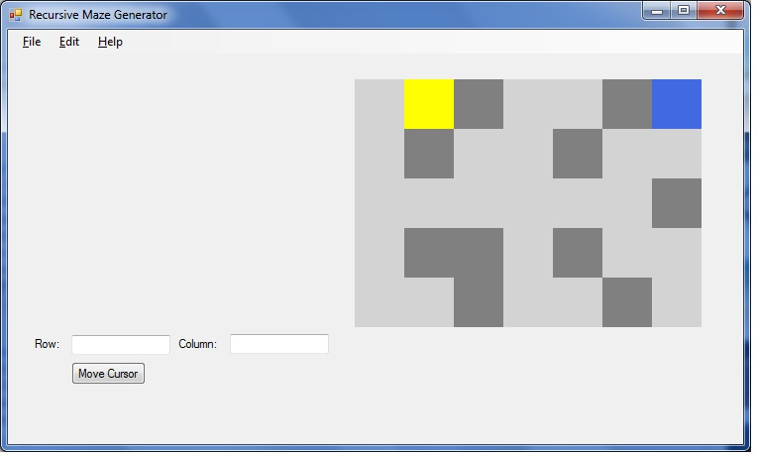
Progress Methods
Part 1:
Research
Part 2:
Design
Maze Generator
API
Part 3:
Testing
Notes:
Research: researching API technology and options
The research was a continuous process throughout the project. As I would double check a piece of code or would need to figure out why a piece would not work.
Design: The design was split into two parts the first being the C# Maze Generator and the second as the DLL Library used to establish the connection between the programs.
Other than starting to research API I first focused on the Maze Generator since it involved much of what I had already learned in class. I then created the dll library before I tested the two pieces together. While in some ways this helped split the work it also increased it since the testing showed several improvements that could be made to the Library file and how the Maze Generator was sending and reading the data
Testing: The Final part was testing everything as a whole and creating test programs to make sure that everything worked as it should.
Simple Maze Layout: created a simple program which would display a few mazes and change color of the squares depending on what the cursor was moved to.
DLL Library Creation: Once I completed most of the maze generator program I moved on to finding a way to connect the two programs. I eventually settled on creating a Library of functions which the second program would use to interact with the maze. Before implementing the library for the project I started with a small tutorial I had found online in order to learn how they were made and how the functions could then be accessed. Once that was done I started working on the projects library.
Connection Tests: I created several different programs in order to test different ways that the programs might be able to send data between each other. ( started with pipes got stuck , moved to files, thought it through and found it would not work, so fixed pipe connections (mostly))

Slide 6
Success
Open and Display
Create and Save
API Connection
Track Path
Detect Blockages
Auto or Step

Slide 7
Exceptions
Game
Extra Controls

Slide 8
Demonstration
Back Up Video
Recursive
Recursive2
Notes:
Go through and show the program. The features. Then show it in action with the other program.

Slide 9
Resources and Strategies
Past Experiences and Classes
Dr. Pankratz and Dr. Mcvey
Internet
Tutorials
Programing Websites
Breaks
Return Visit
Notes:
For much of the project I relied upon what I learned from the classes that I took over the last four years as well as what I learned through programing the various projects that we given.
While I did not actively seek much help from Dr. Pankratz or Dr. Mcvey they both did help greatly

Slide 10
Knowledge Base
Programming Languages
Pipes
Recursion
Past Classes
Notes:
Most of what I used had its source as something that we learned in one of our classes. Which I then enhanced with what I have experienced or from various tutorials and programming sites found online.
Language Sentence
I also used what I knew about pipes to help create the connections between the two programs. For this however I had did extensive research before I realized that pipes could be used to connect two programs.

Slide 11
Future Upgrades
More Controls (ex. Speed, undo, reset, ect)
Non Programming Implementations
Visuals
Connection Stabilization
Integrate and Test with other Languages

Slide 12
Advice
Start Early and Work Regularly
Document Code and Ideas
Notes:
Start Early and Work Regularly
Though a project might be able to be completed by starting later it is defenatly easier to start sooner.
Document Code and Ideas
Not only does this save time at the end but it also helps with debugging since You have access to your thoughts and ideas from the time that you created the code which makes it easier to go through since you do not have to translate your own code

Slide 13
Questions

